Slide 1
Projektseminar Eingebettete Systeme
Topic: Early warning systems for seizure detection
Winter Semester 2023/24 Hossein Safakish

Slide 2
Agenda
. Introduction and Motivation
. Seizure detection and ways
. Advantages and Disadvantages
. Seizure prediction and ways
. Combination of ways
. Closed-Loop systems
. Best way to implement analytical method for Embedded systems
. Challenges
. Conclusion
. References

Slide 3
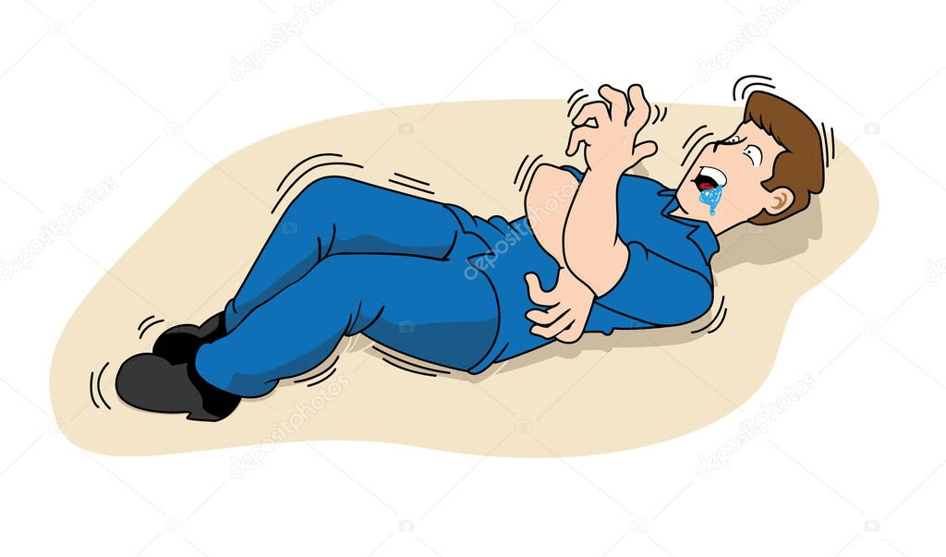
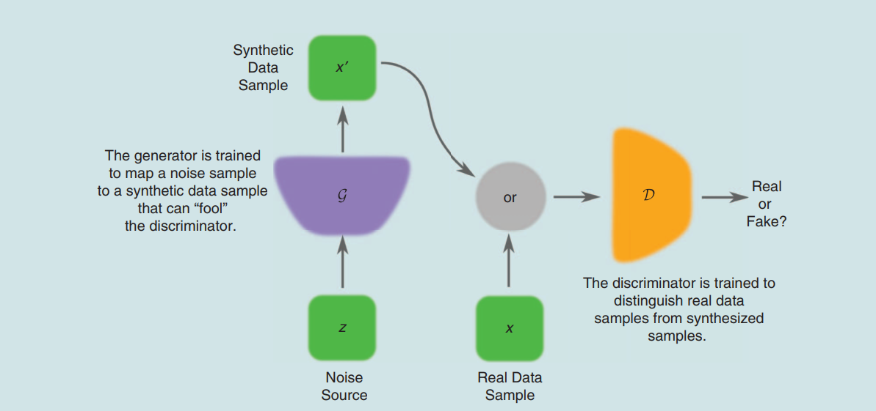
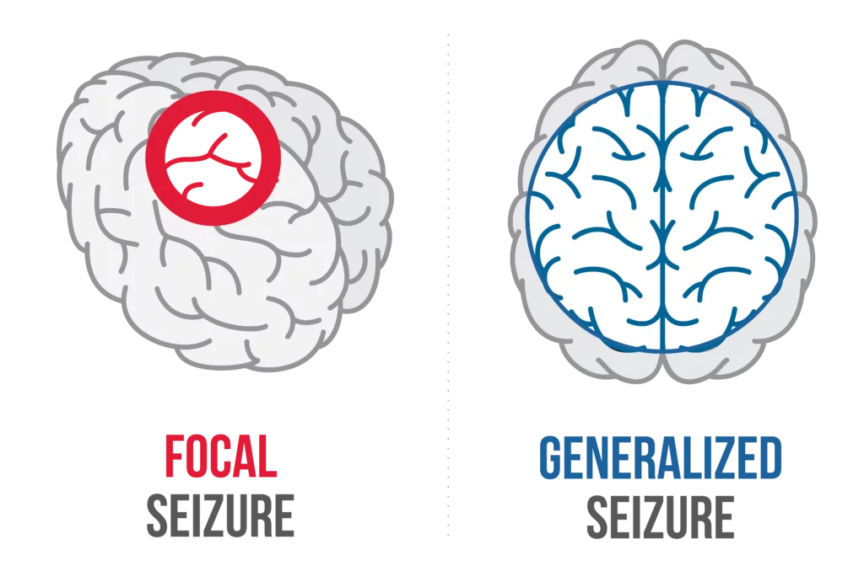
Introduction and Motivation
One of the most common neurological disorders.
Focal (one side of the brain) and generalized (both sides of the brain) are the two types of epileptic seizures that lead to jerking or stiffness of muscles, causing a person to fall or experience a loss of awareness.
The quality of life is low due to the occurrence of seizures.
One-third of patients, even with medication, experience seizures.
The main motivation:
We aim to mitigate or even prevent seizures by detecting and predicting them.
Figure 1. Occurrence of seizure [1]
Figure 2. Focal and generalized seizure [2]

Slide 4
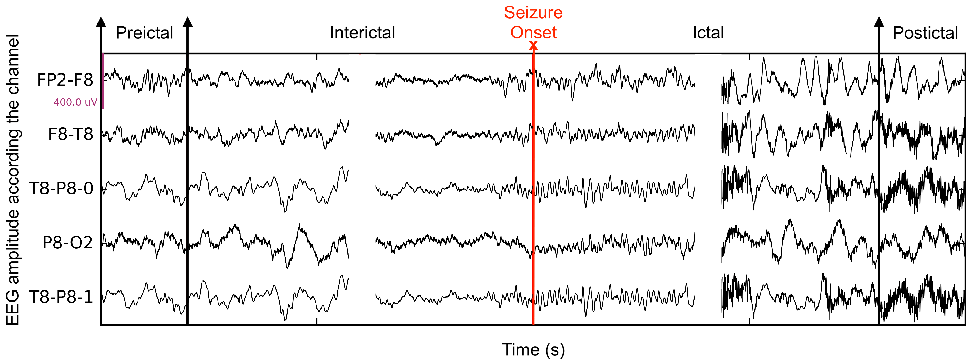
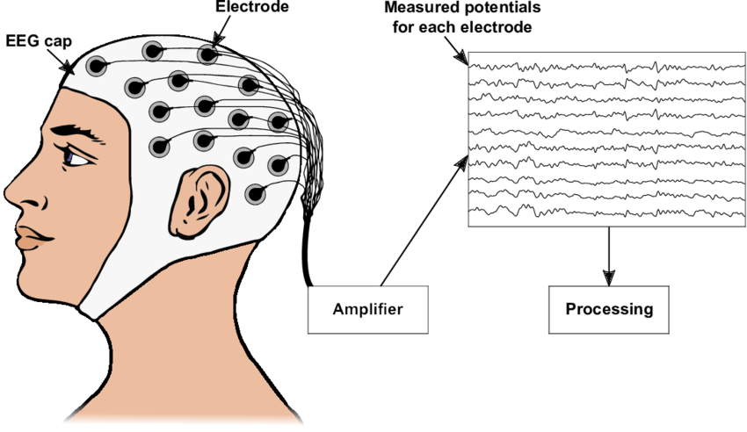
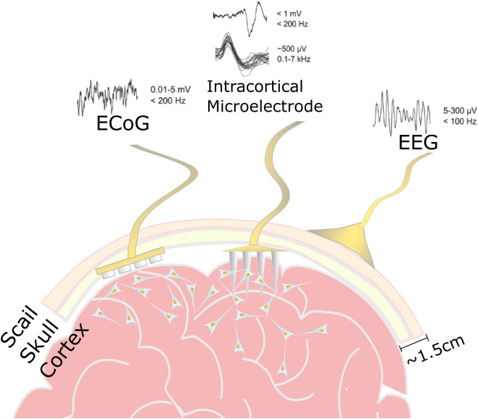
Seizure detection and ways
1. Electroencephalogram (EEG)
2. Electrocorticography (ECoG)
- Electrode grid is positioned on the exposed brain cortex. - Invasive method but more accuracy.
Figure 3. EEG Electrode [3]
Figure 4. EEG Record [4]
Figure 5. ECoG Electrode [5]

Slide 5
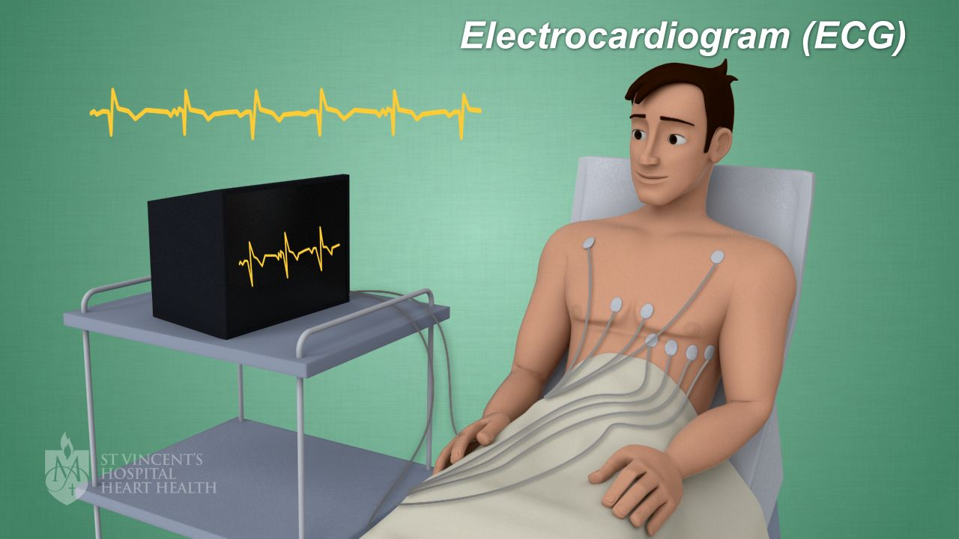
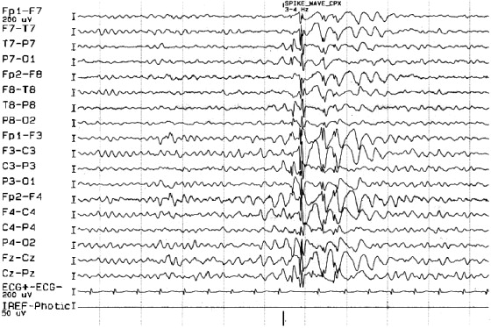
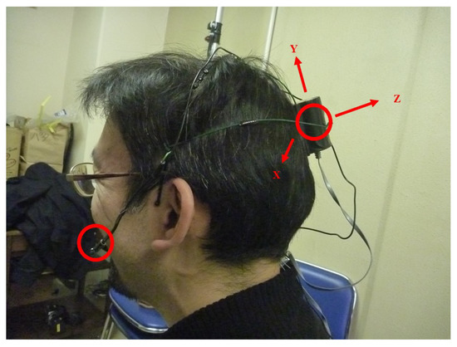
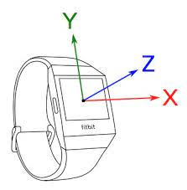
Seizure detection and ways
3. Electrocardiography (ECG)
4. Accelerometry
- Measuring and recording acceleration or movement patterns
- Suitable for motor seizures (tonic-clonic or myoclonic)
- Tachycardia (increased heart rate)(tonic-clonic seizures) - Bradycardia (decreased heart rate)
Figure 6. ECG Record [6]
Figure 7. ECG Electrode [7]
Figure 9. Accelerometry [9]
Figure 8. Accelerometry [8]

Slide 6
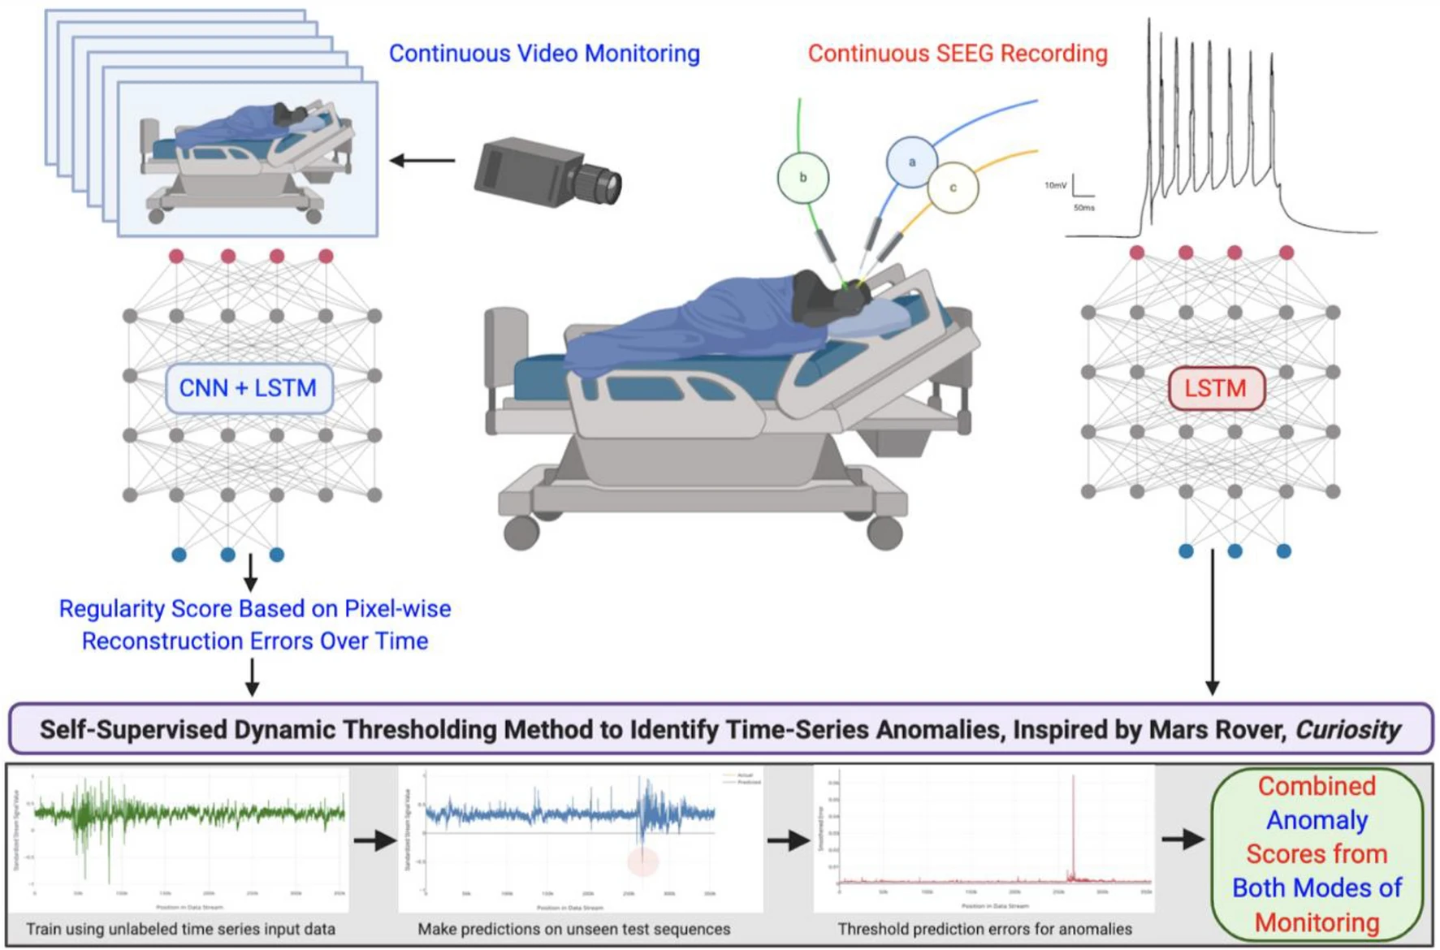
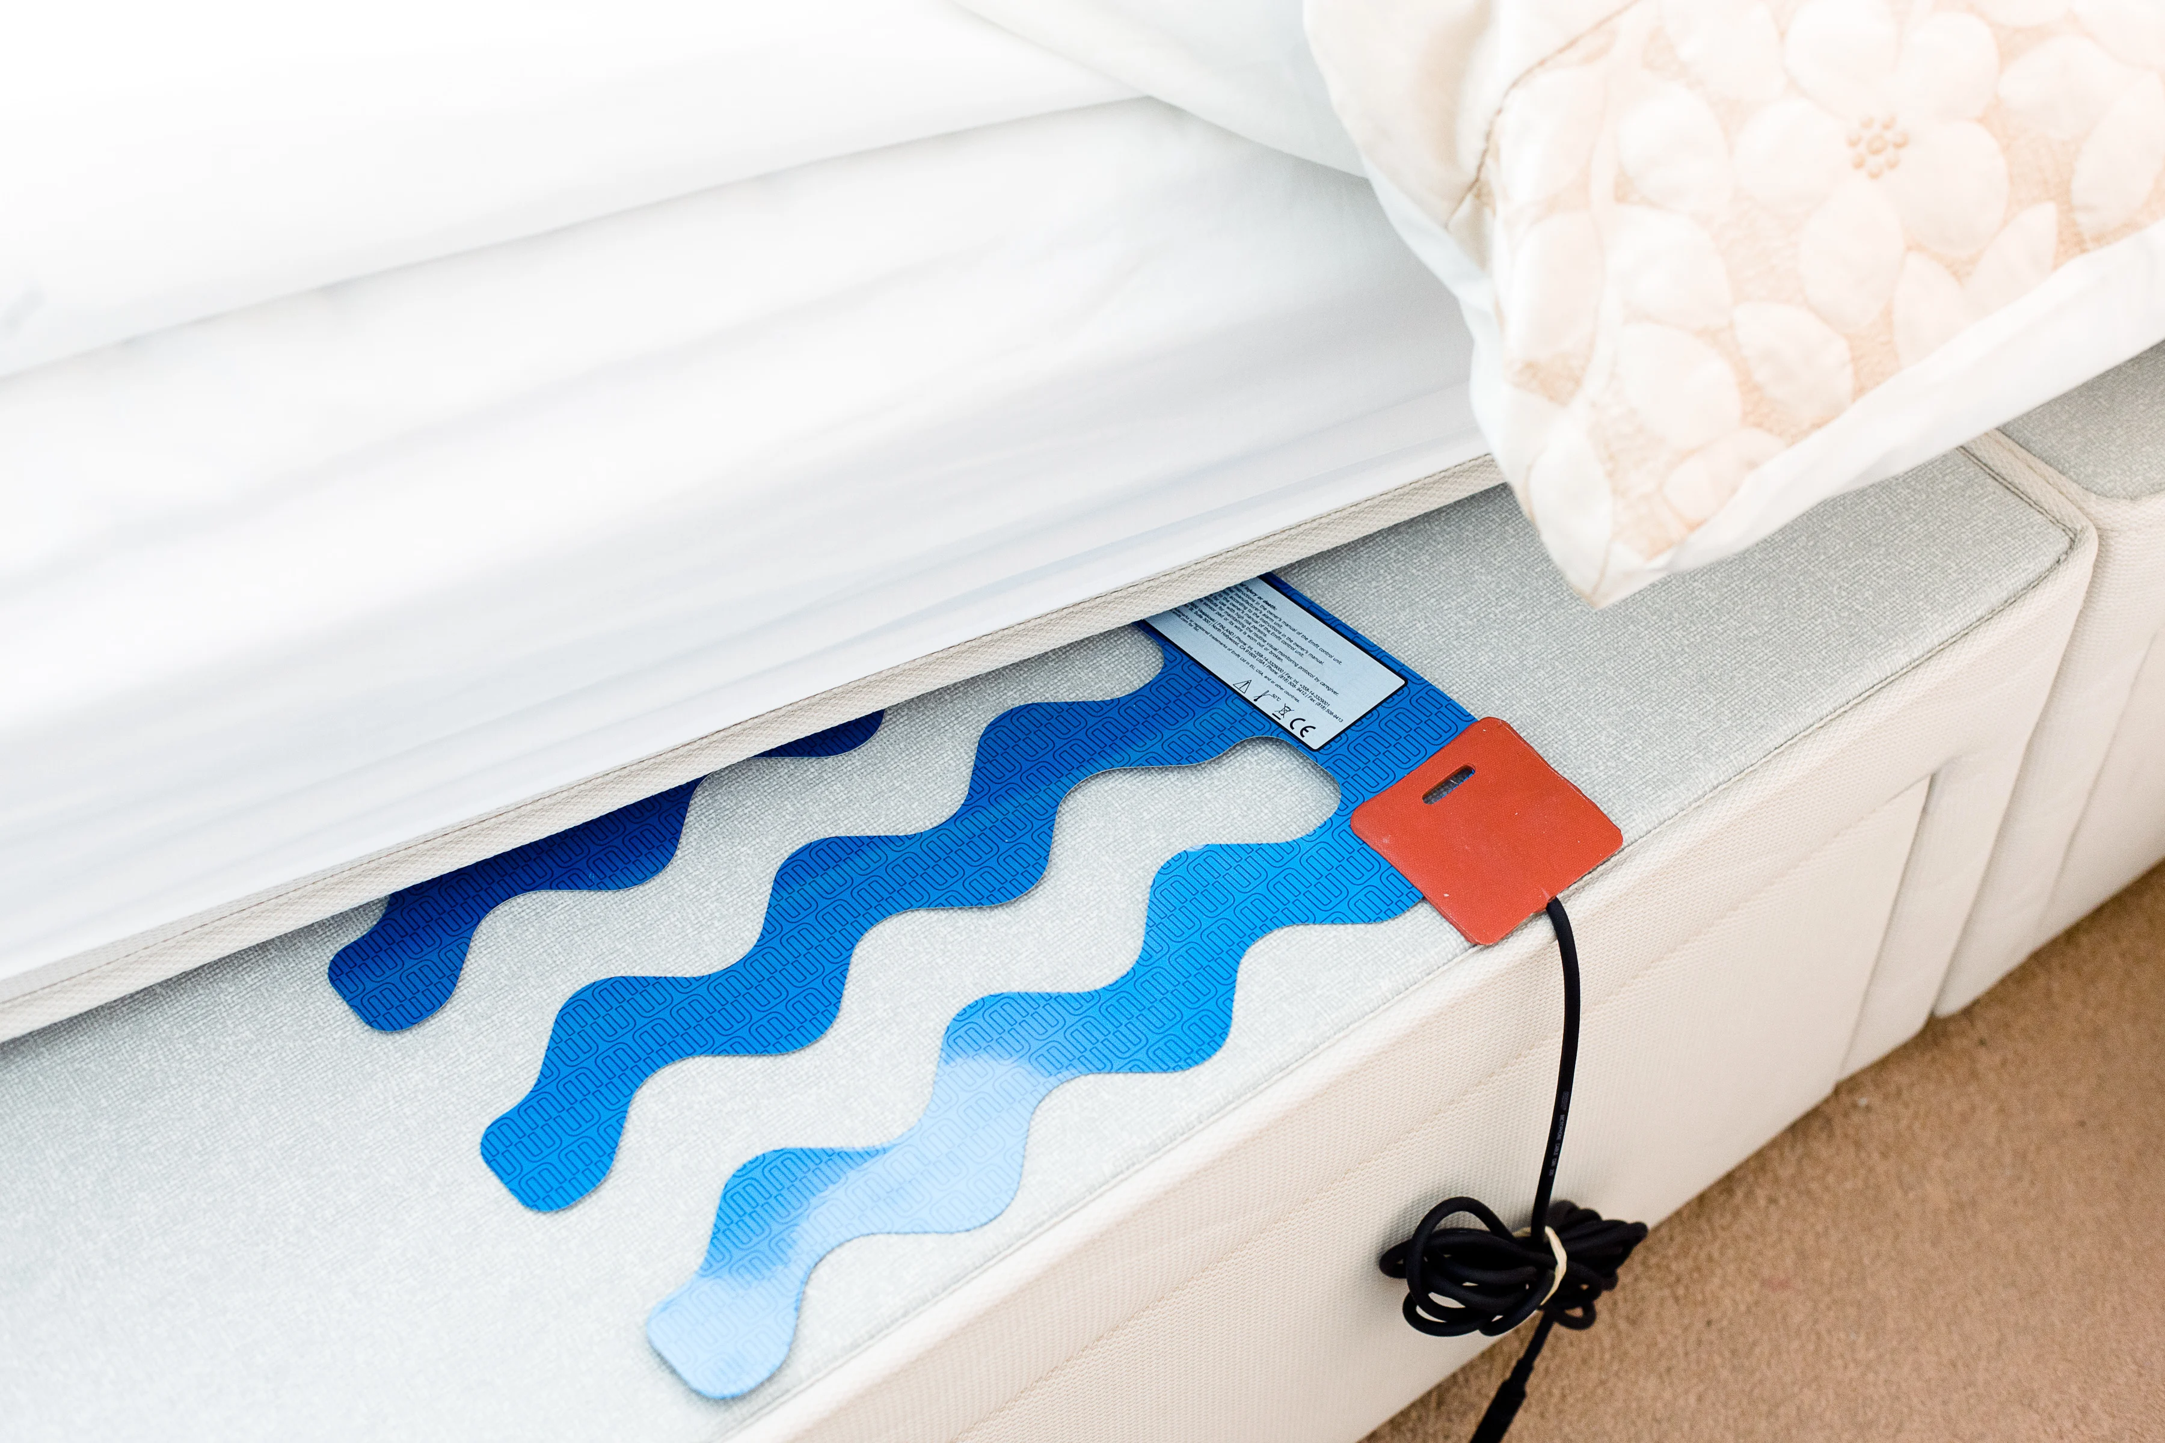
Seizure detection and ways
5. Video detection
Motion trajectory methods track the path of moving objects over time.
6. Mattress sensor This is used to detect tapping and spring noise, aiming to detect seizures during sleep.
Figure 10. Video detection [10]
Figure 11. Mattress sensor [11]

Slide 7
Advantages and Disadvantages
Methode | Advantage | Disadvantage
Electroencephalography (EEG) | Noninvasive with valuable data in detecting epileptic seizures. | Low spatial resolution
Electrocorticography (ECoG) | More accurate compared to EEG | Invasive procedure
Electrocardiogram (ECG) | Narrow relation of tachycardia in preictal phase | Rhythmic cardiac changes can be observed in other physiological and pathological conditions, especially in older patients
Accelerometry | Able to detect movement changes in x, y, and z planes. Used in seizures with motor component. | Any sudden movement can be registered as a seizure event
Video detection systems | Recognizing kinematic patterns of seizure | Miss the seizure when patient is under covers or out of the camera's range
Mattress sensor | Nocturnal seizures, especially tonic–clonic seizures. | High negative predictive value

Slide 8
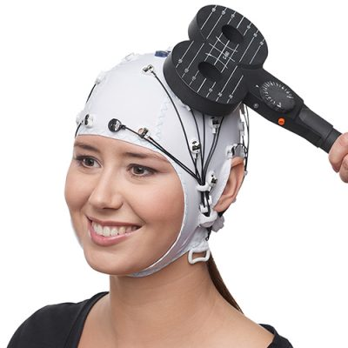
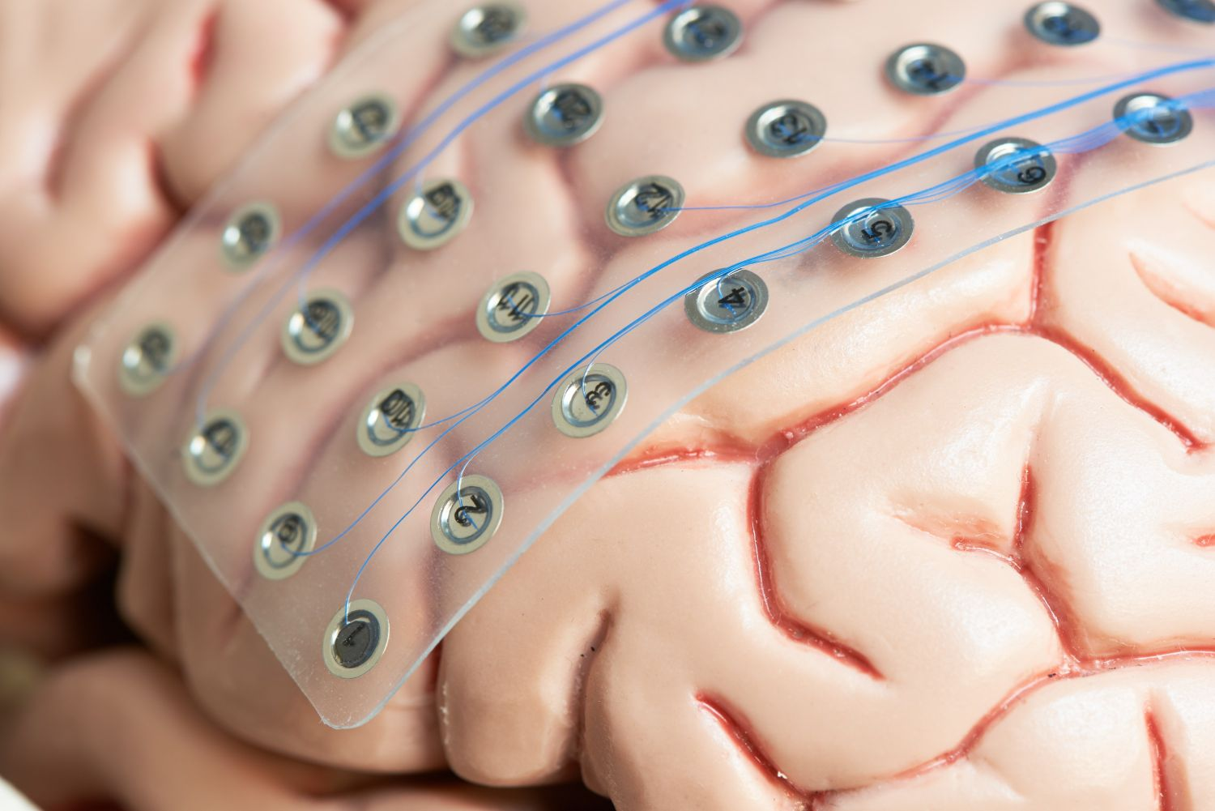
Seizure prediction and ways
- Prevent accidents, improve outcomes, and enable early treatment or even seizure prevention - Preictal phase is very important.
- EEG and ECoG: 7 hours before a seizure, classification with SVM or ANN is necessary.
They are poorly tolerated by patients for long periods, but ECoG alleviates this.
- Electrical probing of cortical excitability:
Transcranial EEG
- Long-term implanted advisory system:
Intracranial EEG
Figure 12. Transcranial EEG [12]
Figure 13. Intracranial EEG [13]

Slide 9
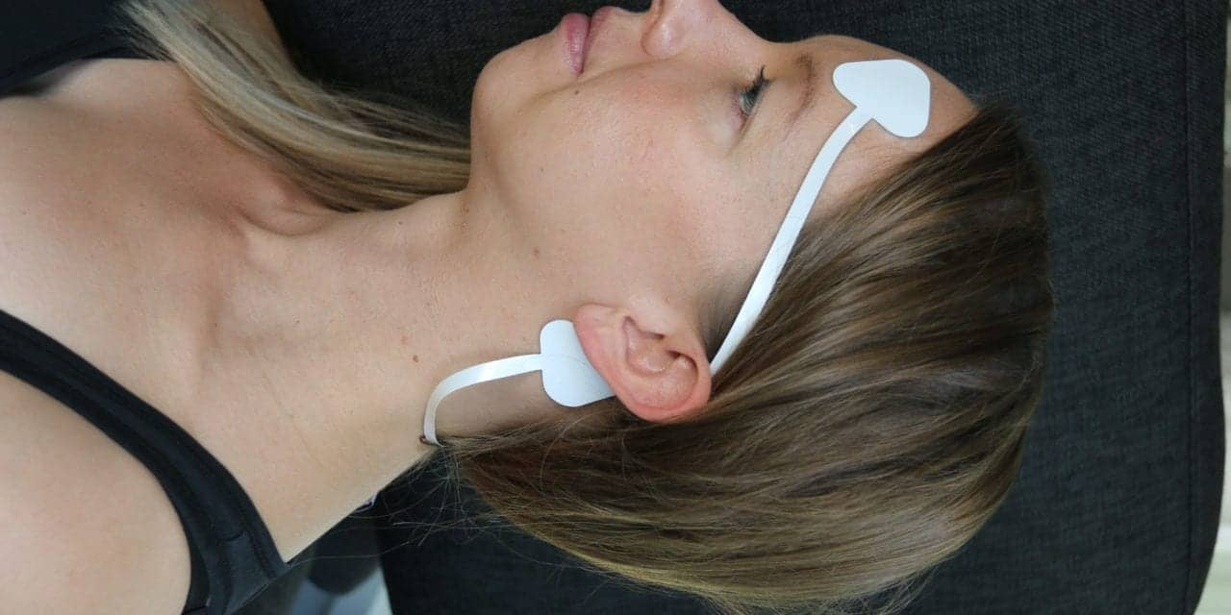
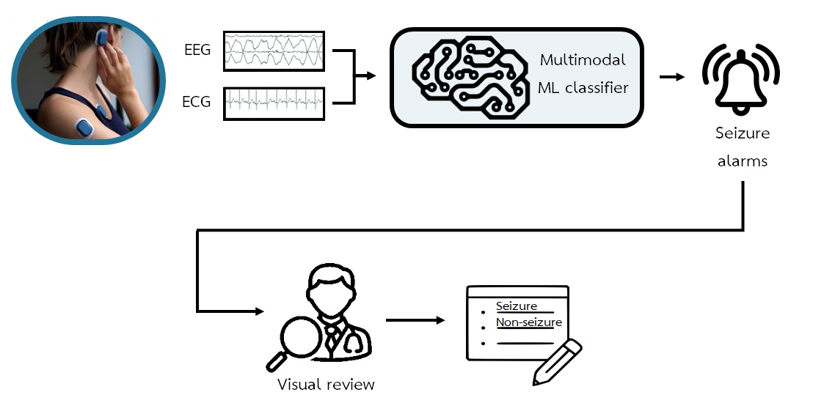
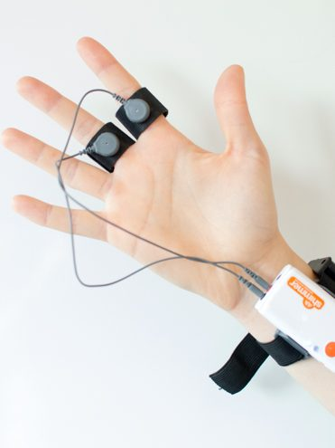
Combined ways
- Combined EEG:
single EEG channel and multiple EEG channels
- EEG and ECG
- Accelerometry and
Electrodermal (sweat secretion)
(related to postictal)
Figure 16. single EEG channel [16]
Figure 3. multiple EEG channels[3]
Figure 17. Electrodermal [17]
Figure 14. Combined EEG and ECG [14]

Slide 10
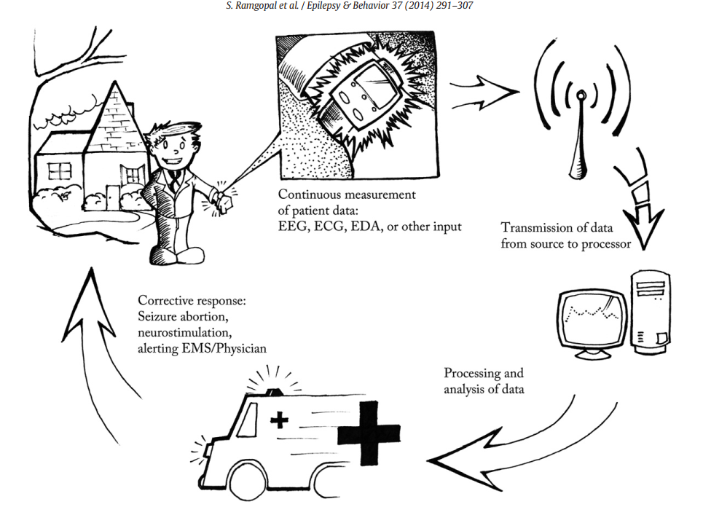
Closed loop systems
Measuring device:
Like a smartwatch & Wearable EEG,…
2. Data transmission:
WiFi or Bluetooth
Privacy and safety
3. Data processing:
data processing is crucial for interpreting the signals collected by the biometric device and assessing the patient's seizure risk in real-time.
4. Response system:
Peltier coolers, UV light, or local drug delivery systems.
(rapid-acting benzodiazepines) To relieve
Figure 15. Closed loop systems [15]

Slide 11
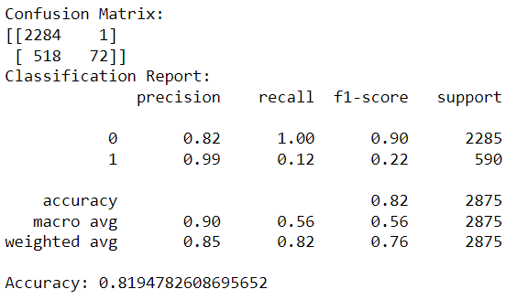
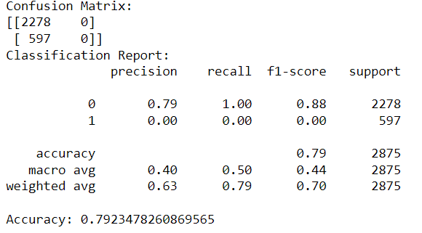
Practical work
I used the dataset for 3 models first SVM then DNN and at the end CNN. We can see here the results and accuracy of them.
SVM
DNN

Slide 12
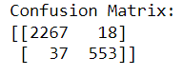
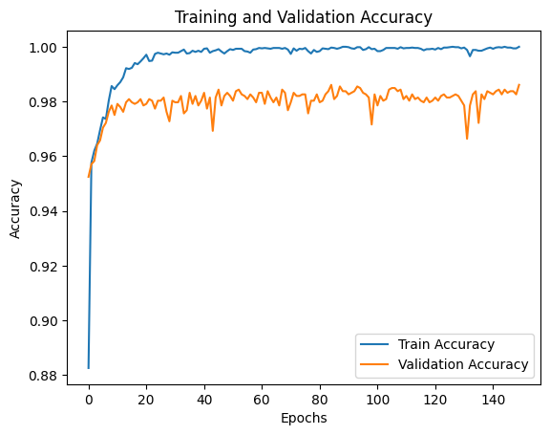
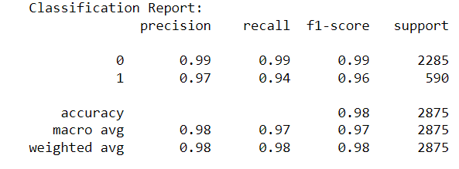
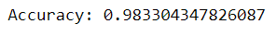
Practical work
CNN

Slide 13
Best way to implement analytical method for Embedded systems
- Requirements of an embedded system include Biometric Sensors (EEG, ECG, EDA,...), Data Acquisition System (ADC...), Processing Unit, and Communication Module (WiFi or BT).
- While algorithms such as FFT, SVM, CNN, RNN, DNN, etc., can meet the requirements, complex algorithms with high computational demands may not be suitable.
- The choice between analytical methods depends on the situation. For real-time responses, it is advisable to use SVM,… for detection, and CNN, etc., for prediction.
- Optimizing energy consumption over an extended period of use is crucial. This optimization can be achieved through careful consideration of factors such as hardware selection, model architecture, and batch size,… .

Slide 14
Challenges
- Ensuring the accuracy of the device
- Real-time data transfer
- Detailed description of seizures
- 24-hour service availability
- Restrictions on independence
- Establishing collaborations
- Validating technology - Complying with safety and effectiveness regulations
Technical
Regulatory
- Market needs - Competition - Costs - Maintenance - Return on investment
CIMIT and
Epilepsy Therapy Project
Market
Funding

Slide 15
Conclusion
Detection is crucial to help patients in emergency cases.
Prediction is essential for aiding patients in understanding ongoing seizures and aborting them.
The combination of methods can increase specificity and accuracy.
The best approach is closed-loop systems because of continuous measurements and analyses of brain, heart and body activity.

Slide 16
References
[1] https://www.1mg.com/articles/national-epilepsy-day-7-common-epilepsy-myths-busted/
[2] https://www.cureepilepsy.org/for-patients/understanding/basics/what-is-seizure/
[3] https://www.researchgate.net/figure/Sketch-of-how-to-record-an-Electroencephalogram-An-EEG-allows-measuring-the-electrical_fig1_338423585
[4] https://www.mdpi.com/2076-3417/11/4/1579
[5] https://www.sciencedirect.com/science/article/abs/pii/S2352492821008412
[6] https://ars.els-cdn.com/content/image/1-s2.0-S1567423103030132-gr2.jpg
[7] https://www.svhhearthealth.com.au/Images/UserUploadedImages/974/06_ECG.jpg
[8] https://encrypted-tbn0.gstatic.com/images?q=tbn:ANd9GcSlNBE3omgK3jYnBWVbTFSo_CfH9NirtWhkcznc8upKSVSTFNNejNNqyX9Do349wLmedHM&usqp=CAU
[9] https://www.mdpi.com/1424-8220/21/9/3162
[10] https://www.nature.com/articles/s41598-021-86891-y
[11] https://www.tunstall.co.uk/our-products/product-catalogue/epilepsy-sensor/
[12] https://pressrelease.brainproducts.com/tms-eeg/
[13] https://www.gillettechildrens.org/your-visit/patient-education/invasive-eeg
[14] https://www.mdpi.com/2306-5354/10/4/491
[15] Ramgopal, Sriram, et al. "Seizure detection, seizure prediction, and closed-loop warning systems in epilepsy." Epilepsy & behavior 37 (2014): 291-307.
[16] https://sleepreviewmag.com/sleep-diagnostics/in-lab-tests/polysomnography/using-a-single-eeg-channel-researchers-new-deep-learning-model-diagnoses-osa-with-82-9-accuracy/
[17] https://imotions.com/blog/learning/research-fundamentals/eda/

Slide 17
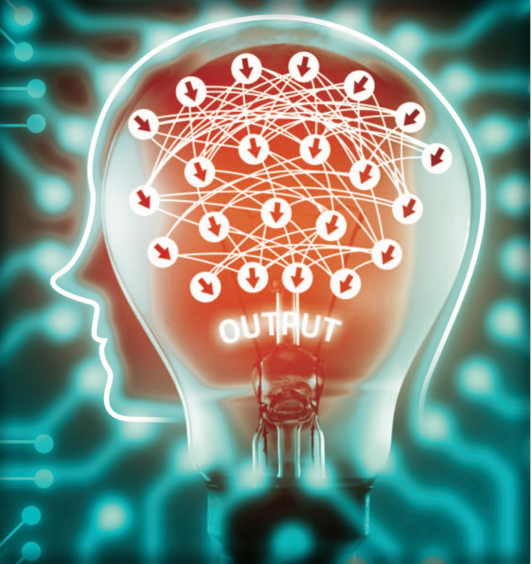
Thank You
©Istockphoto.com/zapp2photo

